Slide 1


Slide 2


Statistical Analysis on factors influencing Life Expectancy
The accuracy of data is an essential factor in the project. World Health Organization's Global Health Observatory, which contains data on health status and many other related factors across all countries, makes these sets publicly accessible for the purpose of analysis of health data. A set of information on life expectancy, and health indicators in 193 countries have been gathered from the WHO database website as well as data relating to its economy was obtained from the websites of the UN.

Slide 3
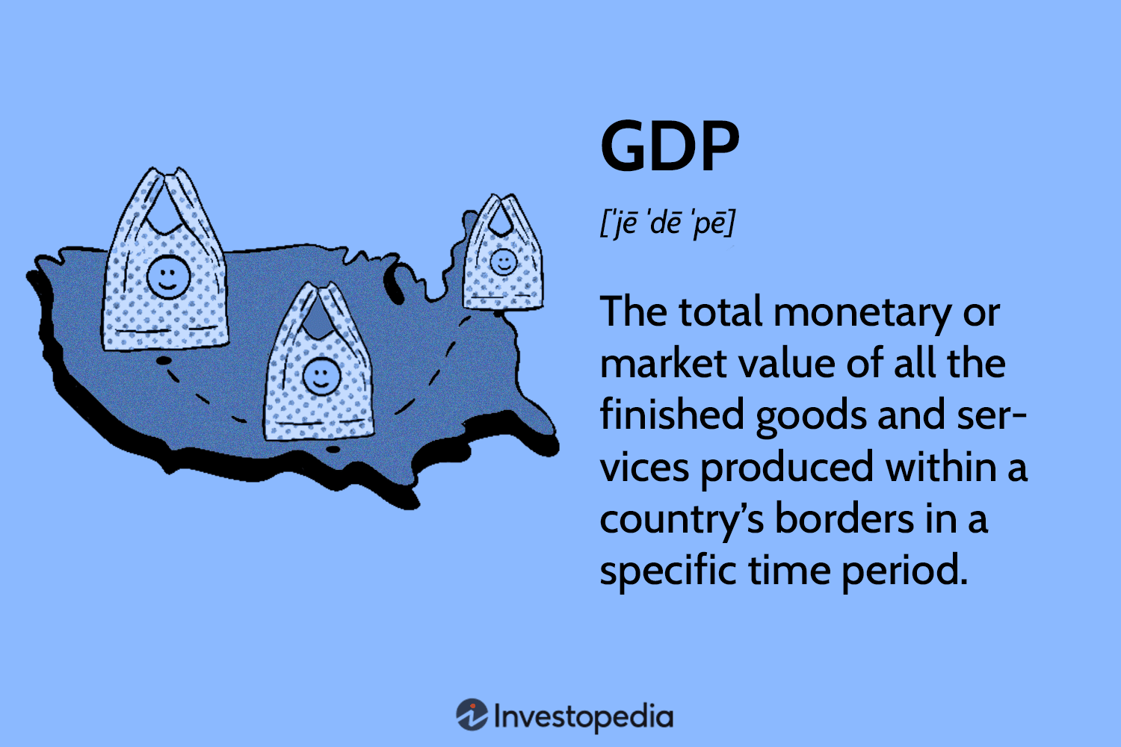

Slide 4
Which country had a maximum increase in life expectancy?
Which country had the maximum decrease in life expectancy?
Is there a correlation between GDP and life expectancy?

Slide 5
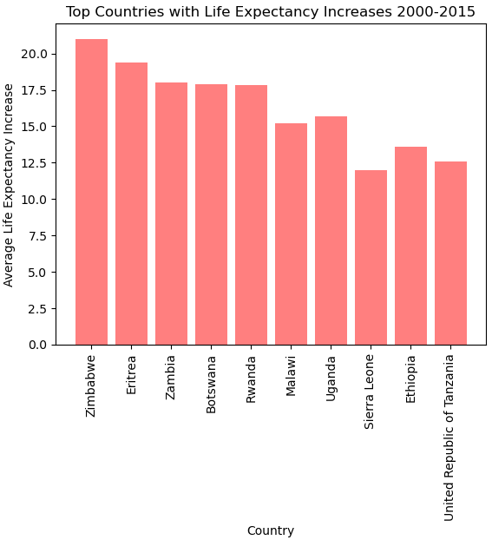
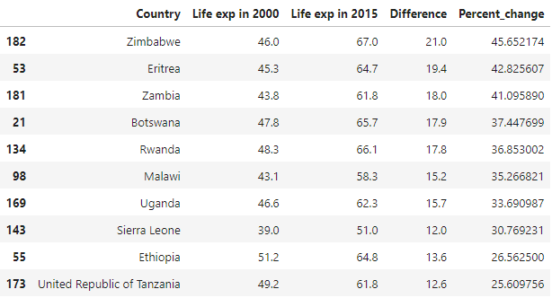
Which country had a maximum increase in life expectancy?
Top 10 Countries
Which country had a maximum decrease in life expectancy?
Is there a correlation between GDP & life expectancy?

Slide 6
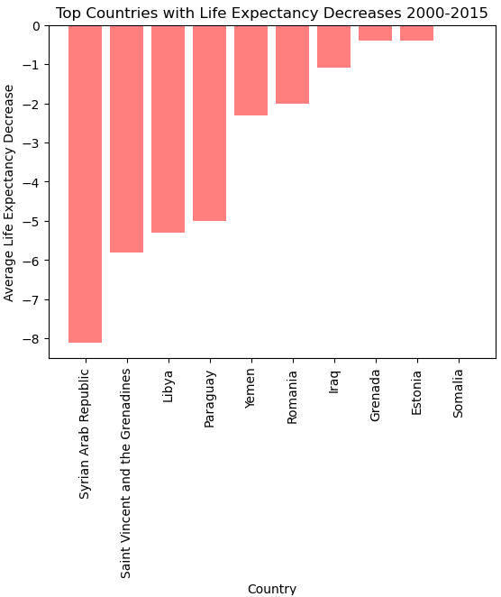
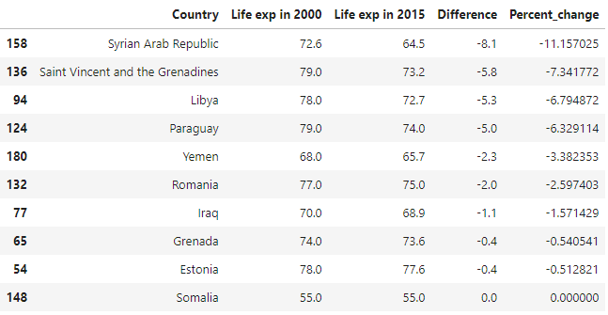
Which country had a maximum decrease in life expectancy?
Top 10 Countries
Which country had a maximum increase in life expectancy?
Is there a correlation between GDP & life expectancy?

Slide 7
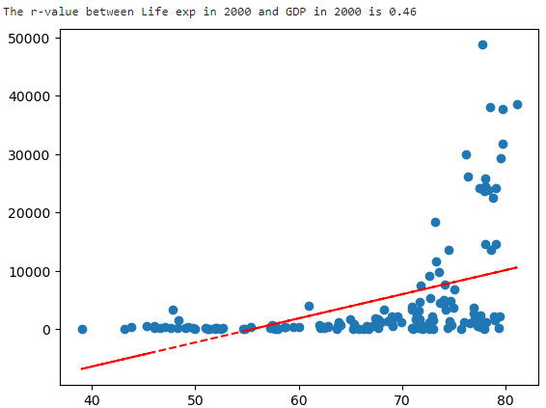
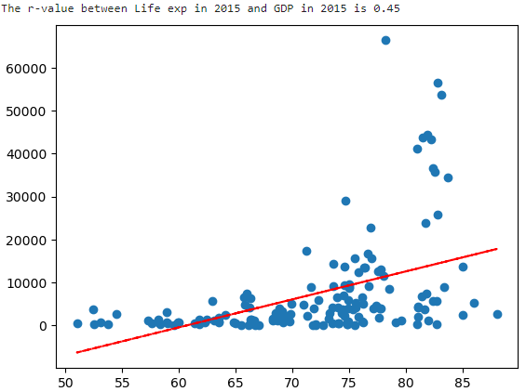
Is there a correlation between GDP & life expectancy?
Life Expectancy & GDP of 2000
Life Expectancy & GDP of 2015
Which country had a maximum increase in life expectancy?
Which country had a maximum decrease in life expectancy?
GDP
GDP
AGE
AGE

